Slide 1
Cup parser installation

Slide 2
Steps
Install jlex if no there : sudo apt-get install -y jlex
Install java (if not there) : sudo apt install openjdk-11-jdk-headless
3. Download the file //java-cup-bin-11b-20160615.tar.gz from the below site
http://www2.cs.tum.edu/projects/cup/install.php
4. Unzip the above file. This contains two jar file:
a. java-cup-11b.jar
b. java-cup-11b-runtime.jar
Extract both the jar file.
a. jar -xf java-cup-11b.jar
b. jar -xf java-cup-11b-runtime.jar
5. Install cup : sudo apt install cup

Slide 3
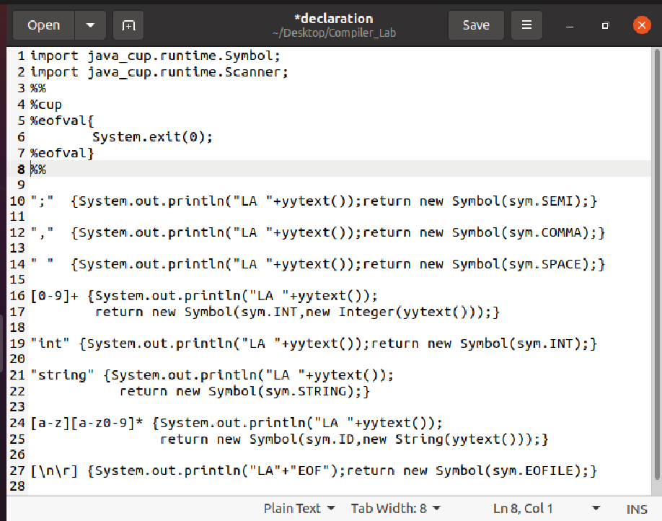
Jlex program
Jlex file name given is declaration

Slide 4
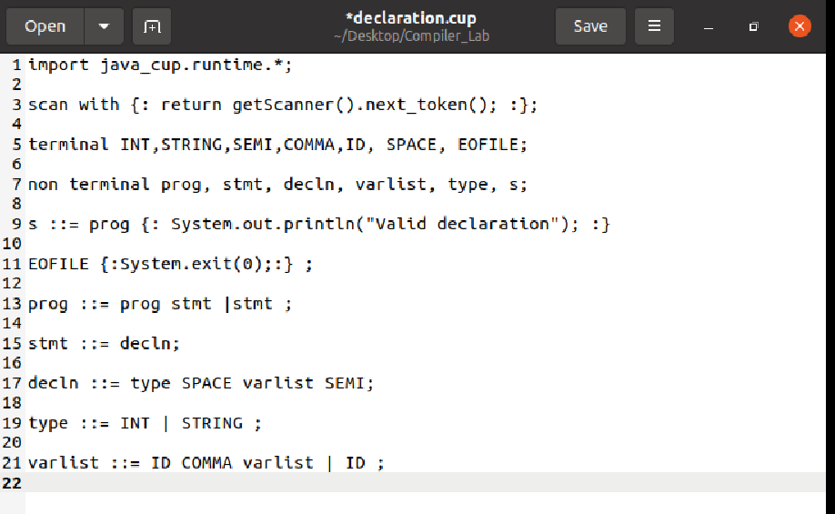
Cup file
Cup file given is declaration.cup

Slide 5
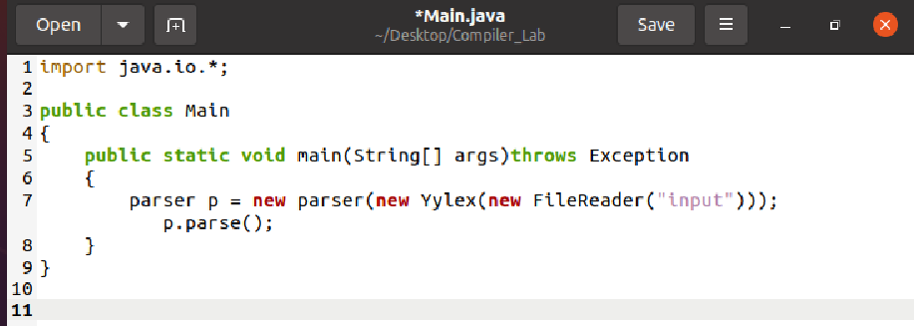
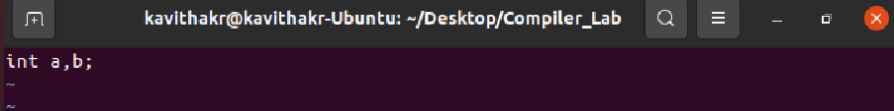
Main.java and input file
Main.java
Input file

Slide 6
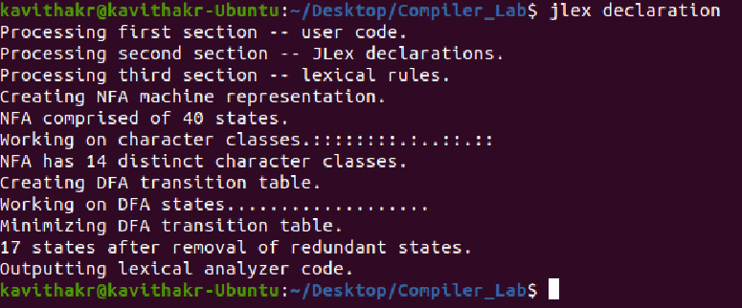
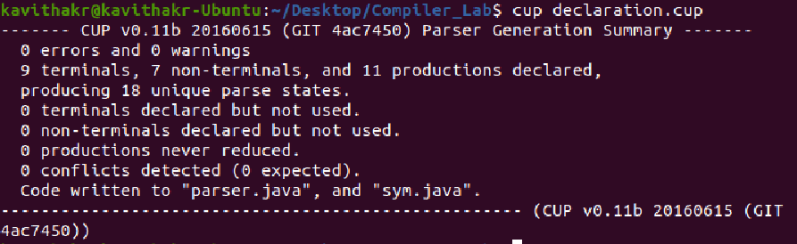
Execution and Running
Run jlex command
Cup command

Slide 7
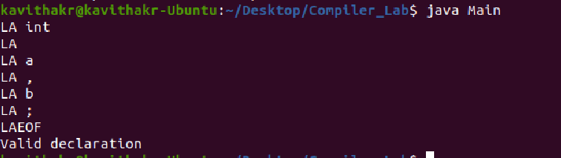
Compile and run

